Slide 1
Stop Bullying
By Eli Kayne

Slide 2
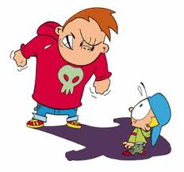
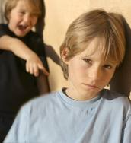
What is bullying?
Bullying is when one person hurts the feelings or physically hurts another person.
A bully can also be a group of people ganging up on someone.

Slide 3
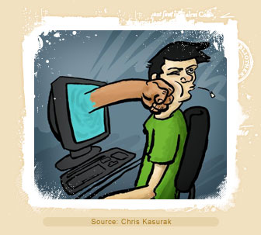
Cyber bullying
Cyber bullying is when you bully through the internet or phones.
It is the easiest way to get caught because people can print or save proof that you were being a bully.

Slide 4
Why is it wrong
It is wrong because it makes the people you bully depressed, unhappy and scared of you.
And if your friends find out they won’t want to be your friend anymore.

Slide 5
How to handle and stop bullying
If you are being bullied don’t fight back just walk away.
If you see some one being bullied go get an adult.

Slide 6
The END
Thanks for watching my slide show! :D
By: Eli Kayne
Jonathan’s Laptop
That sausage I ate this morning!
That Snickers bar that inspired me!

