Slide 1
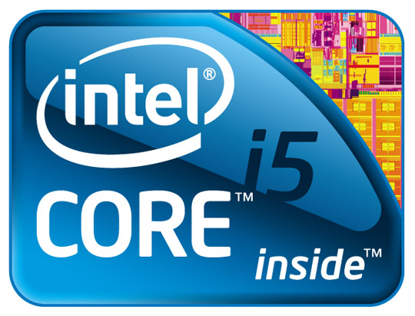
Processors.
By:
Jonathan Kayne

Slide 2
What Is a Processor?
A Processor is a device that Processes data. This is done by Moving data from the hard-drive to the RAM.
RAM is known as Random access Memory.

Slide 3
How Its Done.
For example, you want to watch a video on youtube. The grey bar on the bottom is how much is been moved to your RAM.
Loaded
Not Loaded

Slide 4
How Its Done.
So, the hard-drive holds memory. The Hard-drive needs to upload a video. The processor is what transfers it to the RAM. A Good processor and bad RAM means the RAM can only hold so much memory.
RAM
processor
Hard-Drive

Slide 5
Flaws.
SPEED
Good processor & Bad RAM.
RAM
P
Bad Processor & Good RAM
SPEED
RAM
RAM
P

Slide 6
Thanks for Watching!!!
Information found by Scott Bolick 16 years old.
By Jonathan Kayne 00001100 years old.

