Slide 1
Binary Code
By
Jonathan Kayne

Slide 2
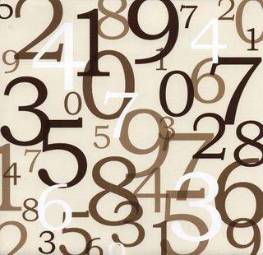
Difference Between Binary & Regular Code.
Regular Code
Regular code is a based 10 code. (0, 1, 2, 3, 4, 5, 6, 7, 8, and 9) That is how we make our code.

Slide 3
Difference Between Binary & Regular Code.
Binary Code
Binary code is a based 2 code, which only consists of 1’s and 0’s.

Slide 4
What is a Bit?
In Comparison, a bit is a digit. So an 8-bit binary code is an 8 digit number.
10101011 10001110

Slide 5
Figuring out binary code
Since it’s a based 2 code the digits multiply by 2. In normal code, the digits are like this 1,000-100-10-1.
In binary code, its this:
8-bit
128-64-32-16-8-4-2-1

Slide 6
Figuring out binary code
Lets take a number, 19 for example, all the numbers more than 19 are 0’s (000) 16 goes into 19 with 3 remainder (0001) the only numbers that make a combination of 3 is 2 and 1. We put 0’s in the 8 and 4 spot (000100) and put 1’s in the 2 and 1 spot and!
00010011=19

Slide 7
What if it’s a 0?
All the numbers are greater than 0 so all the #’s are 0’s.

Slide 8
Thanks for watching!
-I got this information on YouTube but I changed it around to make it easier.

